Slide 1



“The more that you read, the more things you will know, the more that you learn, the more places you’ll go.” —Dr. Seuss

Slide 2

13th August,2023
To
Software Development Proposal Ceremony

Slide 3






Bangladesh University of Business and Technology
Department of CSE
Intake-49
Section-08
Mushfiqur Rahman Pulok
ID:21225103525
Md Mehedi Hasan
ID:21225103334
Abdullah Al
Hill Baki
ID:21225103341
Faiza Khandoker Fama
ID:21225103338
Jannatul Ferdous
ID:21225103350

Slide 4
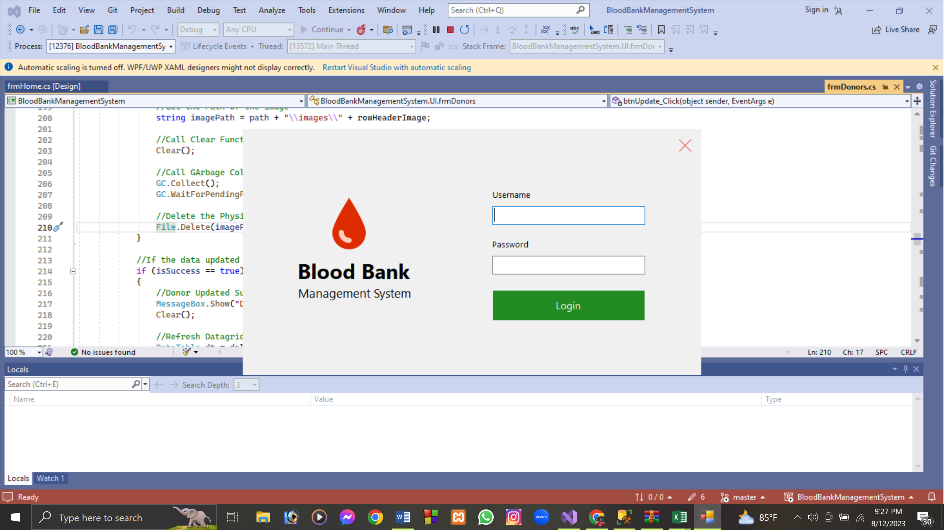

Let's Talk About
"Saving Lives, One Drop at a Time: Empowering Care through Blood Bank Management System."

Slide 5

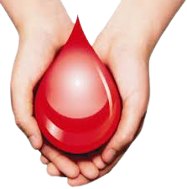


Introduction
To
Blood Bank Management System

Slide 6


A Blood Bank Management System is a software application designed to efficiently manage the operations of a blood bank or blood donation center. This system aims to streamline and automate various tasks related to blood donation and distribution. It serves as a comprehensive tool for both blood bank staff and donors to ensure the availability of safe and compatible blood products for patients in need.
Need Blood?
What is then?

Slide 7


Why we have chosen
Blood Bank Management System?

Slide 8



Currently, dengue has become epidemic in Bangladesh. Due to this many people are suffering from anemia and platelet deficiency. Finding the necessary blood has become difficult. People often post online or message their group for necessary blood but it doesn’t help them much. Some organizations even maintain a list of donors and their details but often they are not updated. It is one of the major reasons why we have decided to make a blood bank management system. Our purpose is to make an application where admins can add or remove details of donors and admin or users can login to update their details. In this way we can help patients with safe blood supply when they are needed.
Exclusive Content
Need Blood?
Powerful Search Functionality
Curated Playlist
Free
Dengue Giveway
Accessible Multiple Devices
Offline Viewing Options

Slide 9


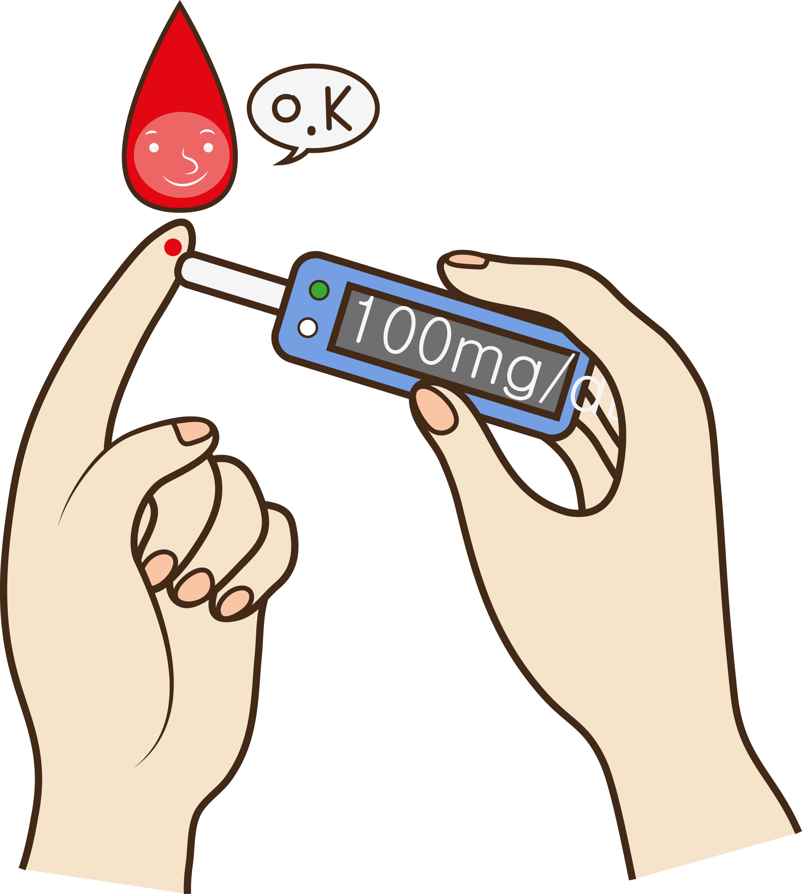

Key features

Slide 10



Add, Update and Delete Users
Register Donors and Keep Their Details.
Admins can manage (Add, Update and Delete) Donors
Login Function

Slide 11



